Slide 1
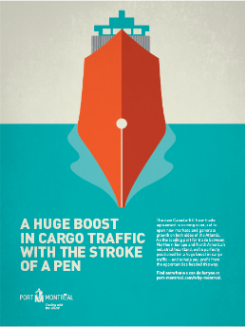
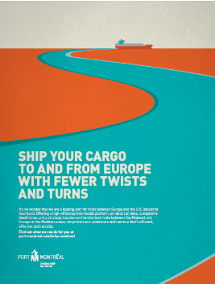
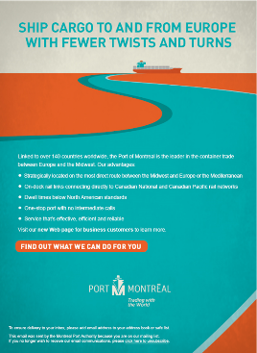
Port of Montreal
Trading with
the World
WEB BANNERS
PRINTED ADS
E-BLASTS
Advertisements – Series
area for logo
(delete text box placing logo)

